Slide 1
Steady State Concentrations and Parameter Calculations Modules

Slide 2
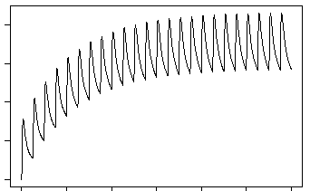
Steady State Concentrations Module Overview
A chemical’s steady state (SS) concentration is its concentration when the rate of chemical entering and leaving the body are equal during repeated exposures
The exposure level (“dose”), clearance rate, and bioavailability of a chemical all play a role in determining SS
Useful in knowing how quickly your chemical accumulates during repeated exposures
Avg SS conc
Concentration
Time

Slide 3
Steady State Concentrations Module Outputs
SS concentrations table and plot for specified dosing amount during a “constant” oral infusion (every hour for 24 hours)
Calculated by a single analytic (algebraic) equation
A table with an estimate on the number of days it takes for your chemical to reach SS
Calculated by comparing the solution above to numerically solving the model for 3x daily oral dosing. When the model reaches SS value from above or when its fractional change is VERY small, then the number of days is recorded.
Avg SS conc
Concentration
Time

Slide 4
Steady State Concentrations Module Inputs
Required:
Species and species preferences (if applicable)
Model selection
In silico parameter preference
Dosing amount
Chemicals to simulate
Optional:
Bioavailability settings
Output units
Output units, concentration type (plasma, blood), and tissue compartment
Model calculation preferences for hepatic clearance, fraction unbound, and partition coefficients

Slide 5
Example 1 Scenario
Goal:
Obtain the mouse steady state concentrations and characteristics of seven food colorings using the pbtk model at 0.5 mg/kg dose per day
Use only mouse data if able
Do not use the available in silico parameters
Use 100% bioavailability
Chemical Name | CASRN
FD&C Red 4 | 4548-53-2
FD&C Yellow 6 | 2783-94-0
FD&C Blue 1 | 3844-45-9
FD&C Yellow 5 | 1934-21-0
FD&C Red 3 | 16423-68-0
FD&C Green 3 | 2353-45-9
FD&C Green 1 | 4680-78-8

Slide 6
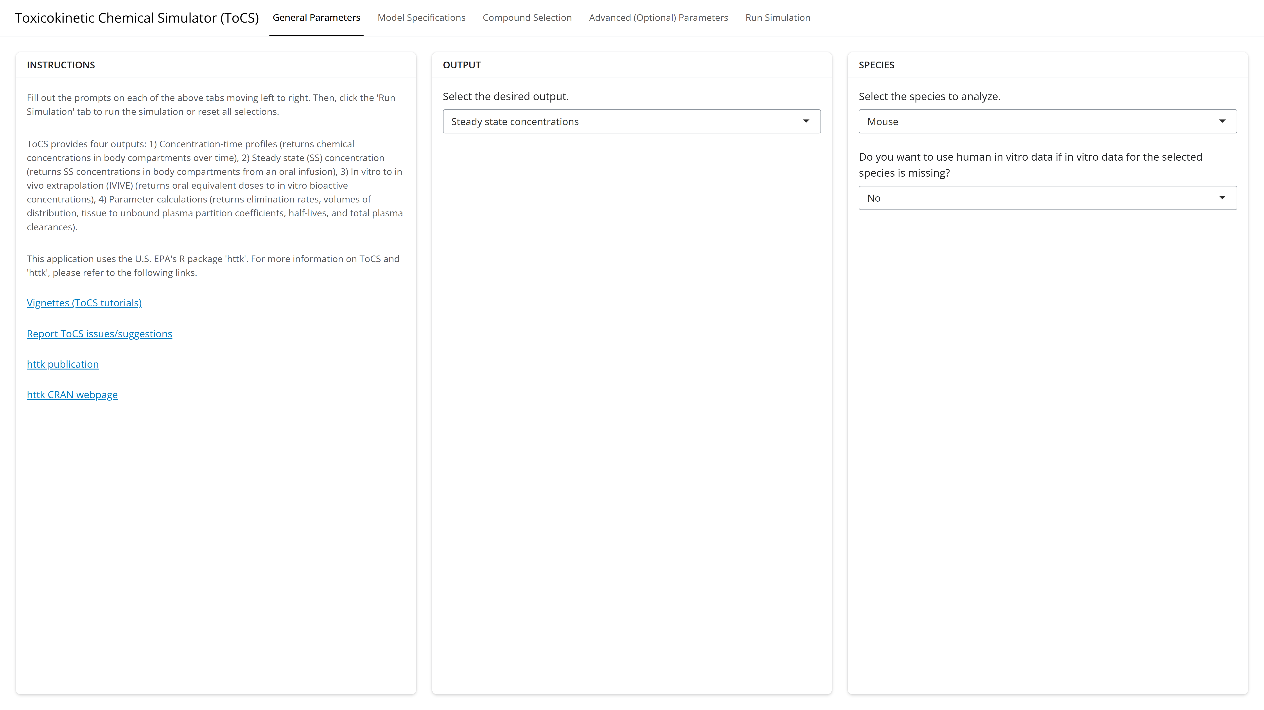
Example 1: General Parameters Tab

Slide 7
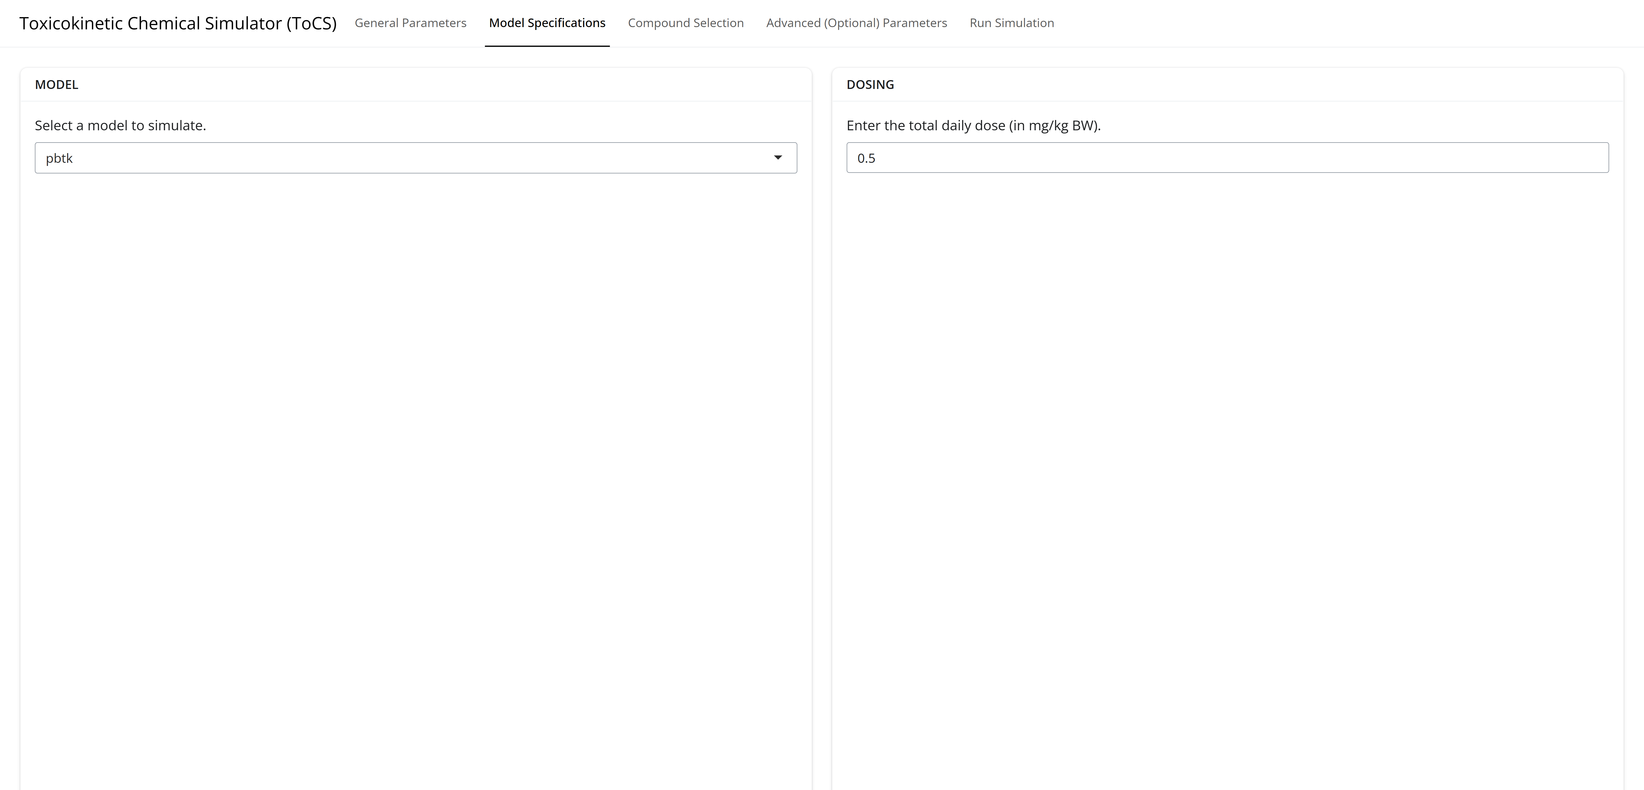
Example 1: Model Specifications Tab

Slide 8
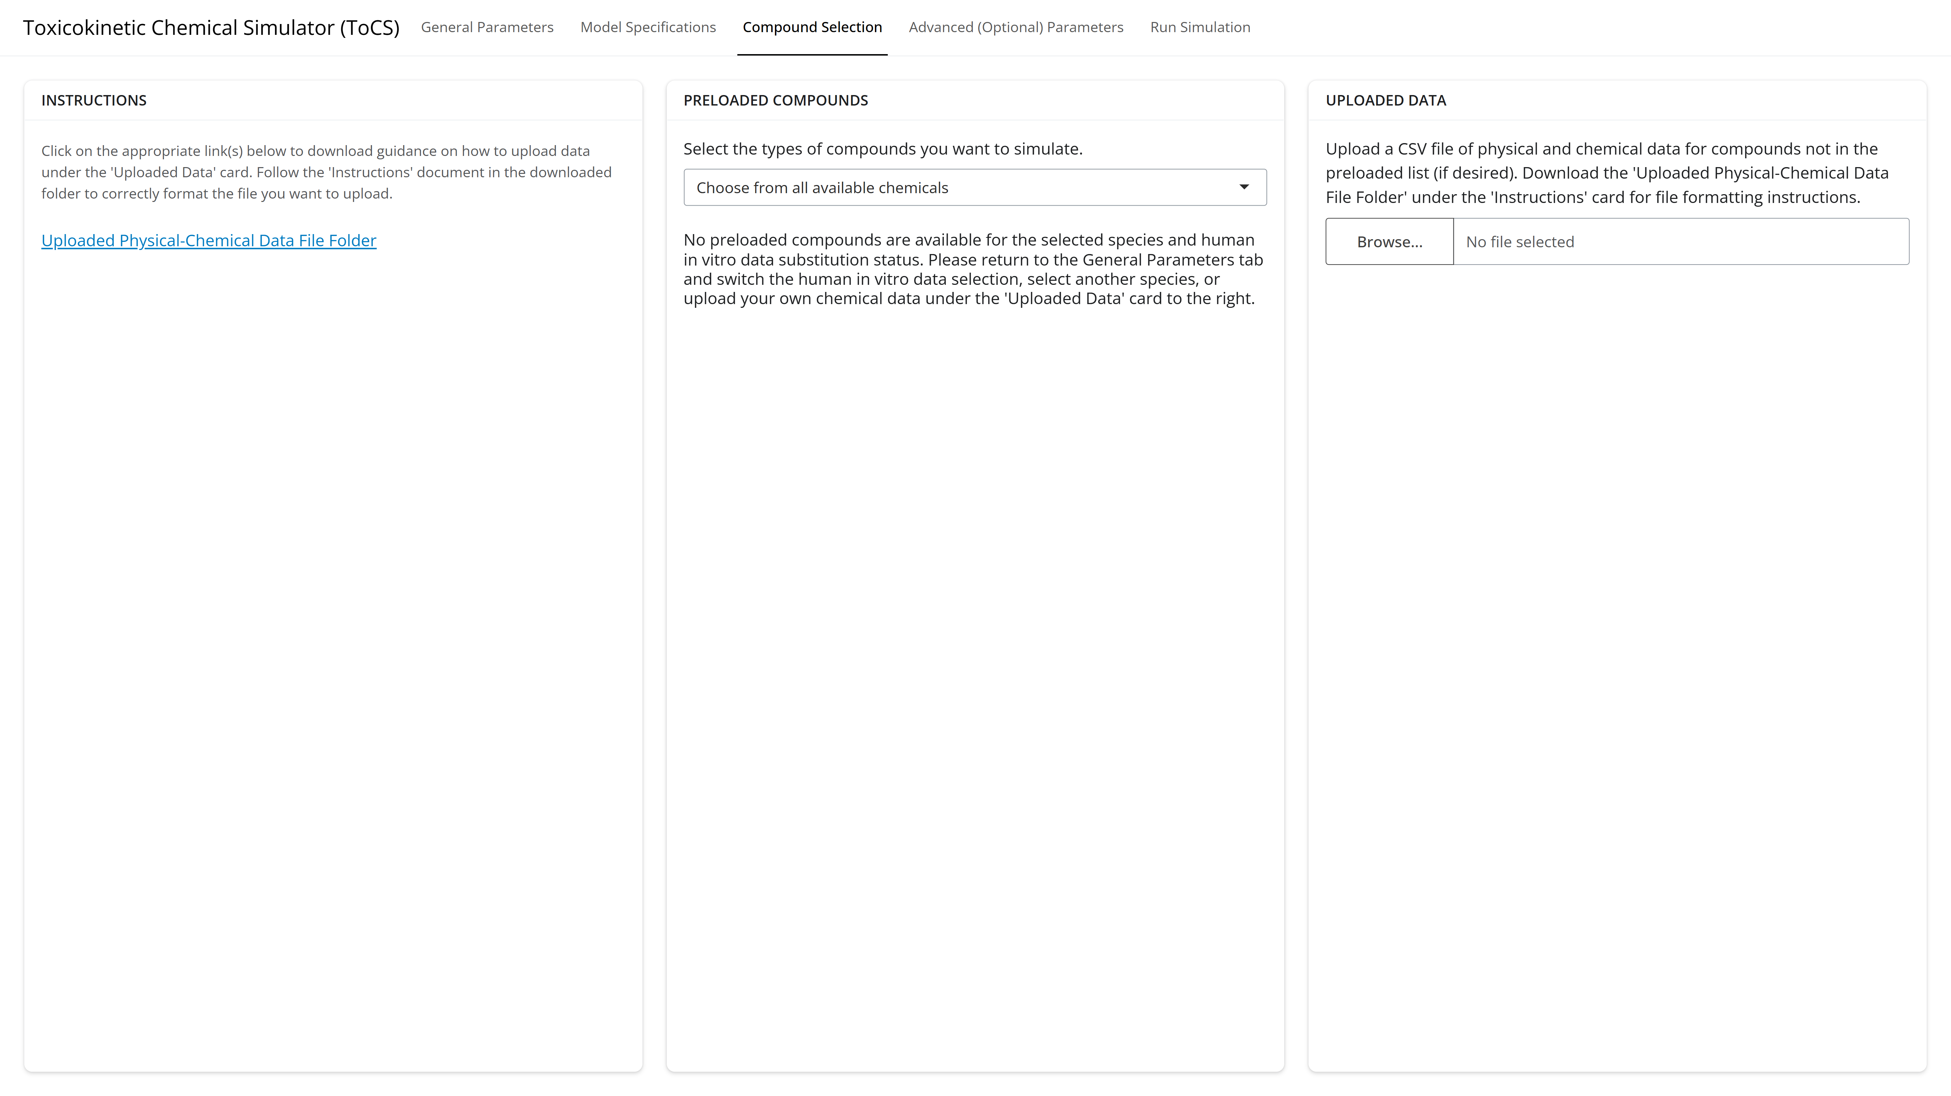
Example 1: Compound Selection Tab
Must change previous selections to include human data!

Slide 9

Example 1: General Parameters Tab

Slide 10
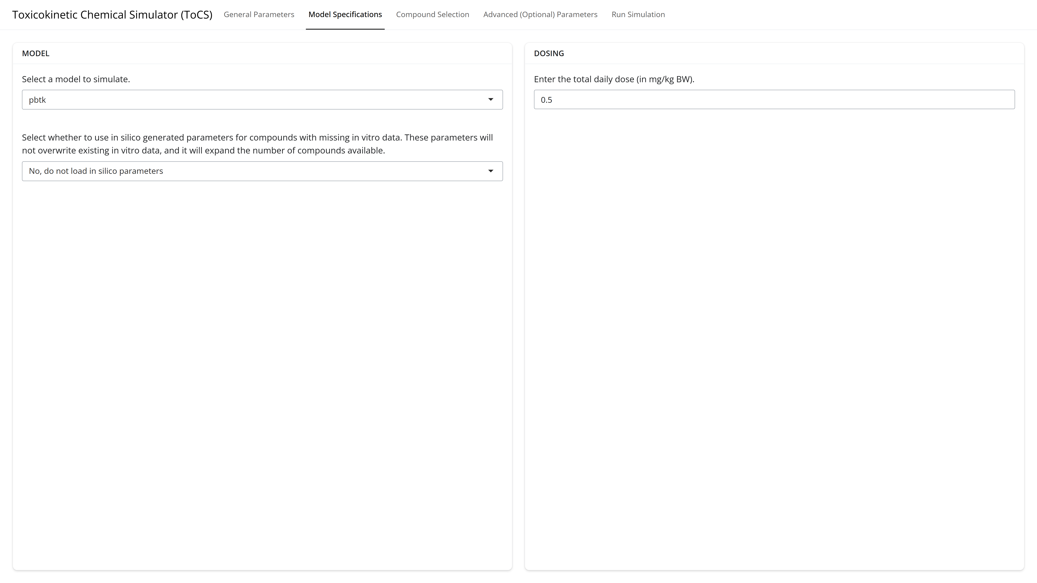
Example 1: Model Specifications Tab

Slide 11
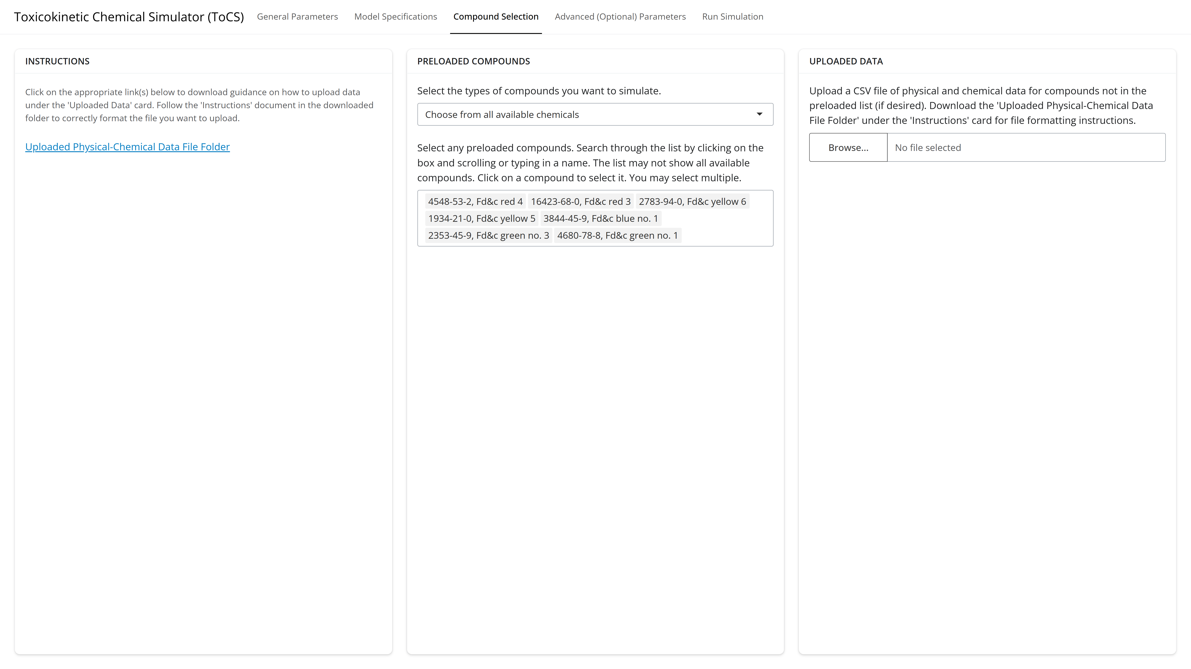
Example 1: Compound Selection Tab

Slide 12
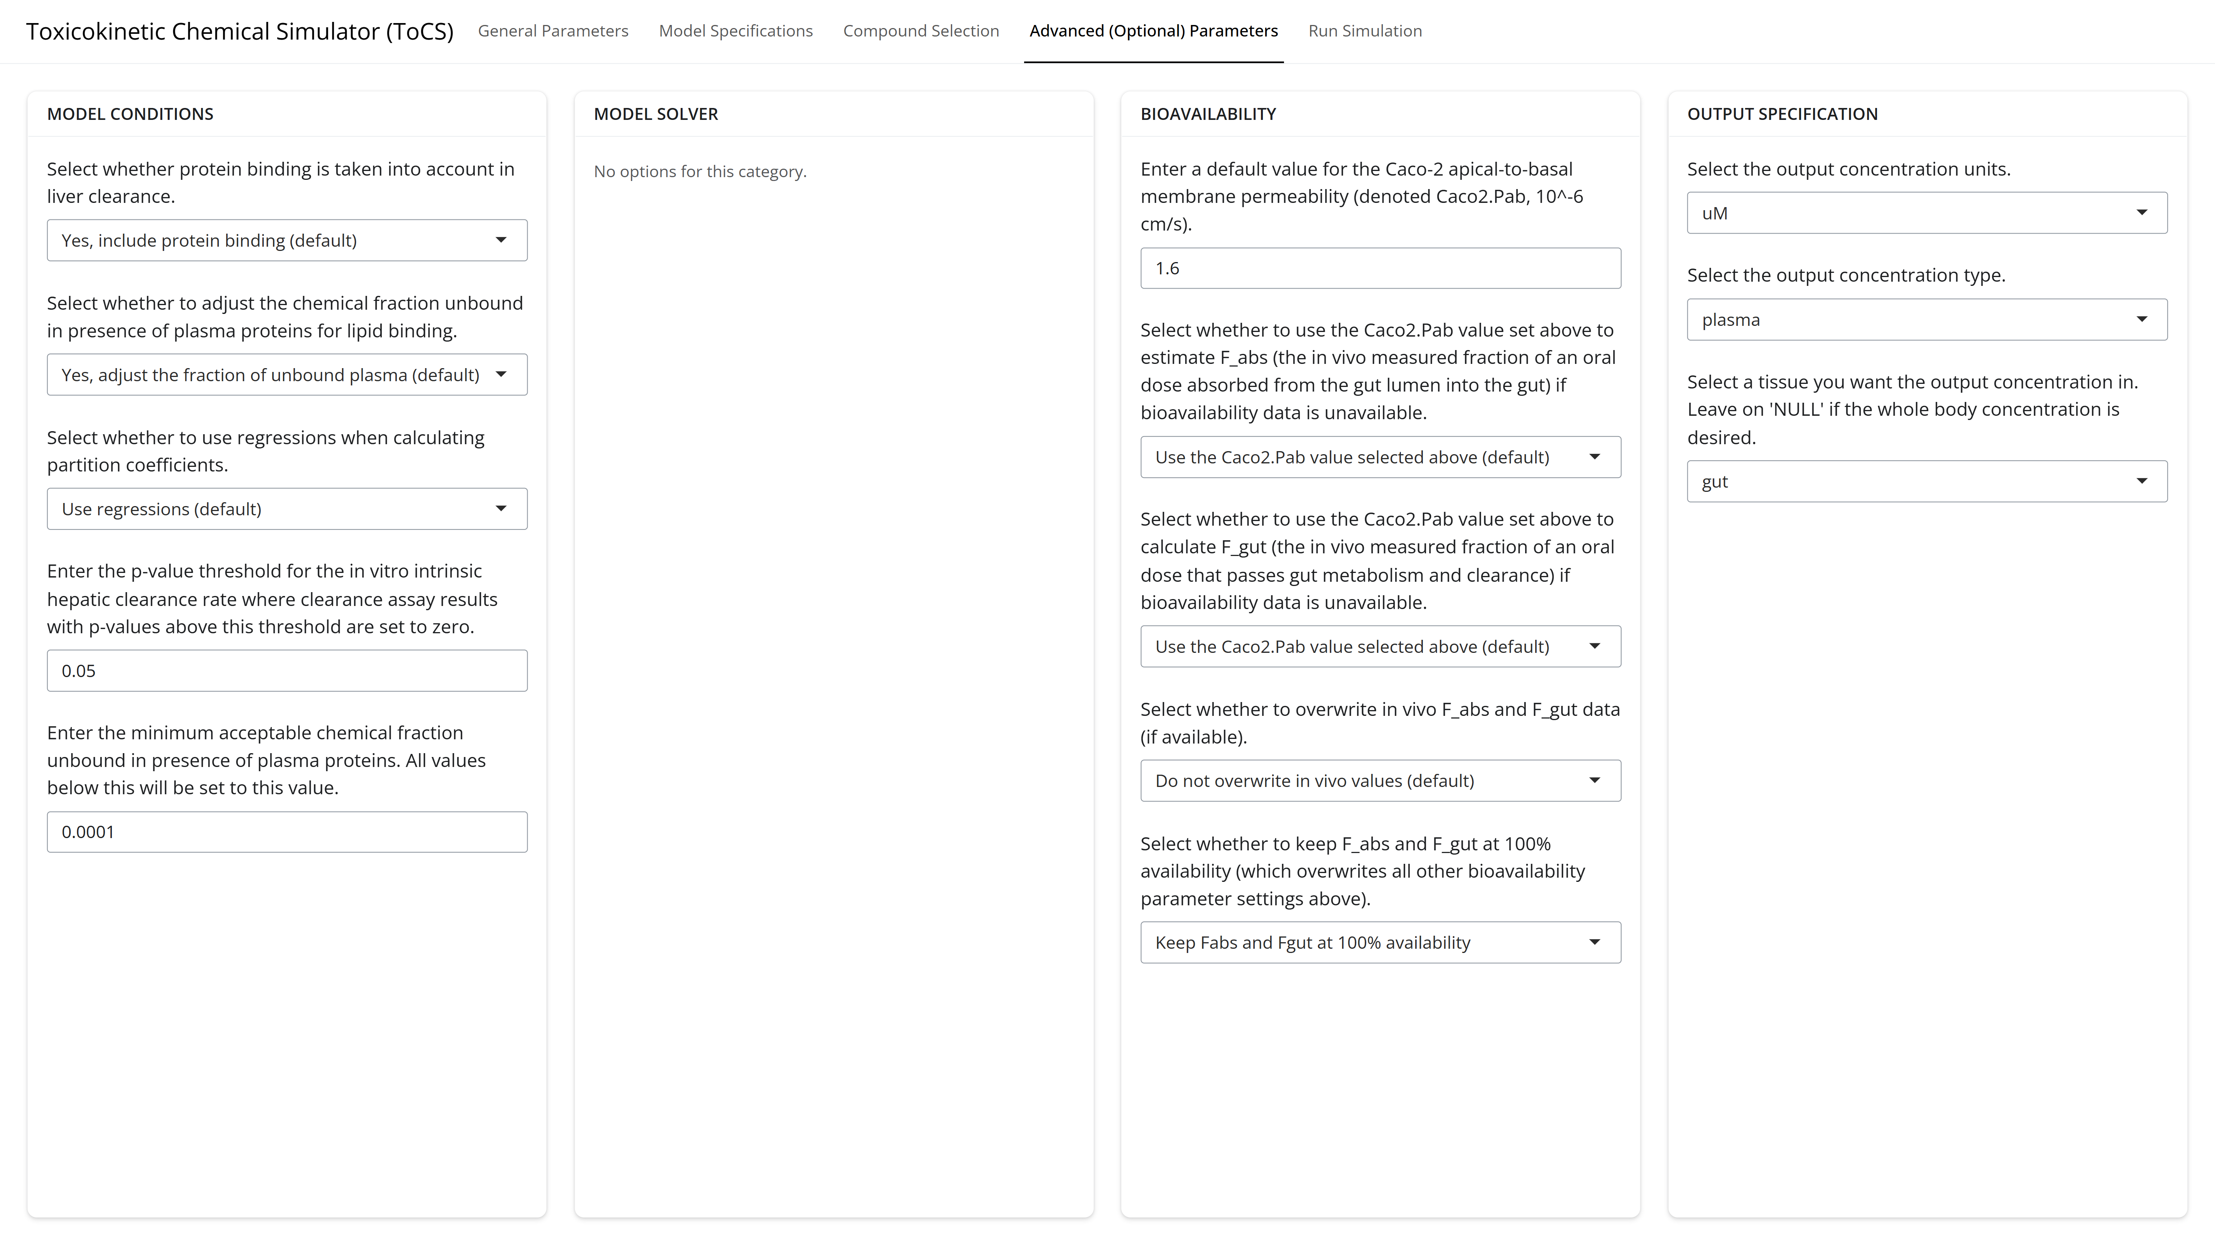
Example 1: Advanced Parameters Tab

Slide 13
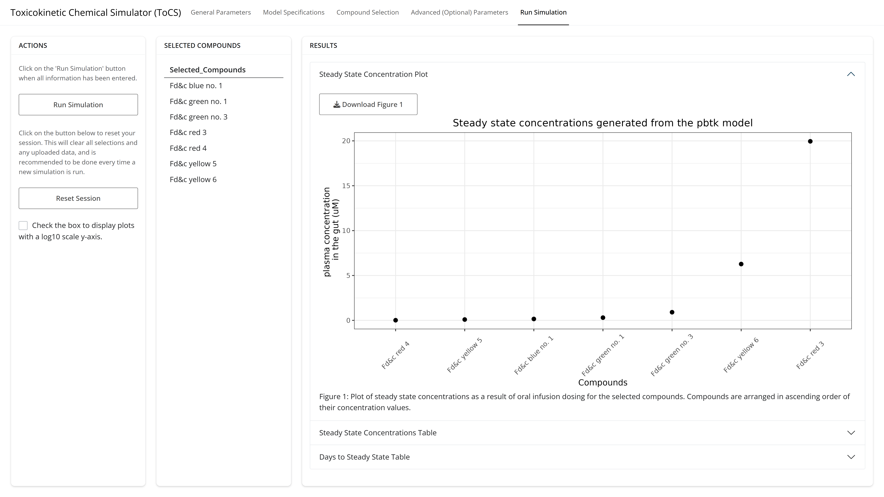
Example 1: Run Simulation Tab

Slide 14
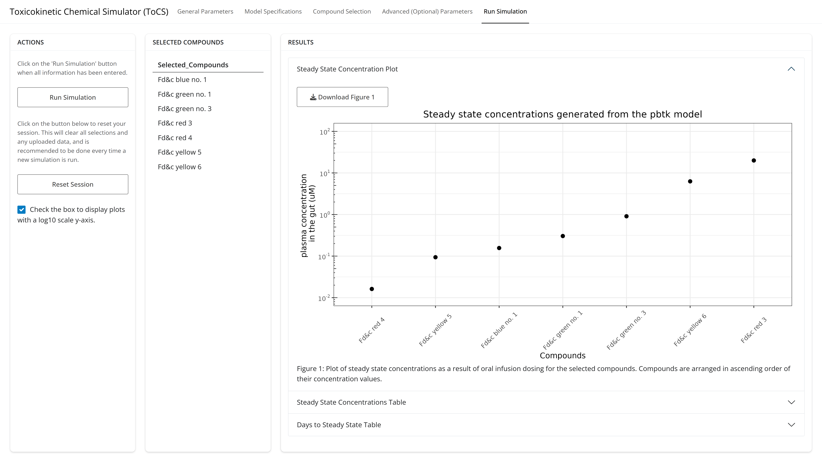
Example 1: Run Simulation Tab

Slide 15
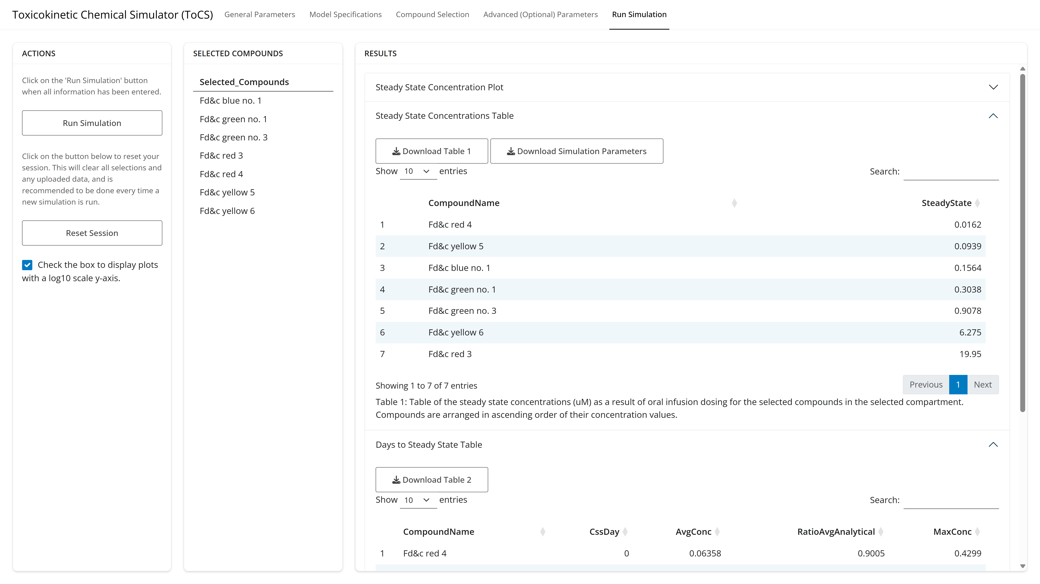
Example 1: Run Simulation Tab

Slide 16
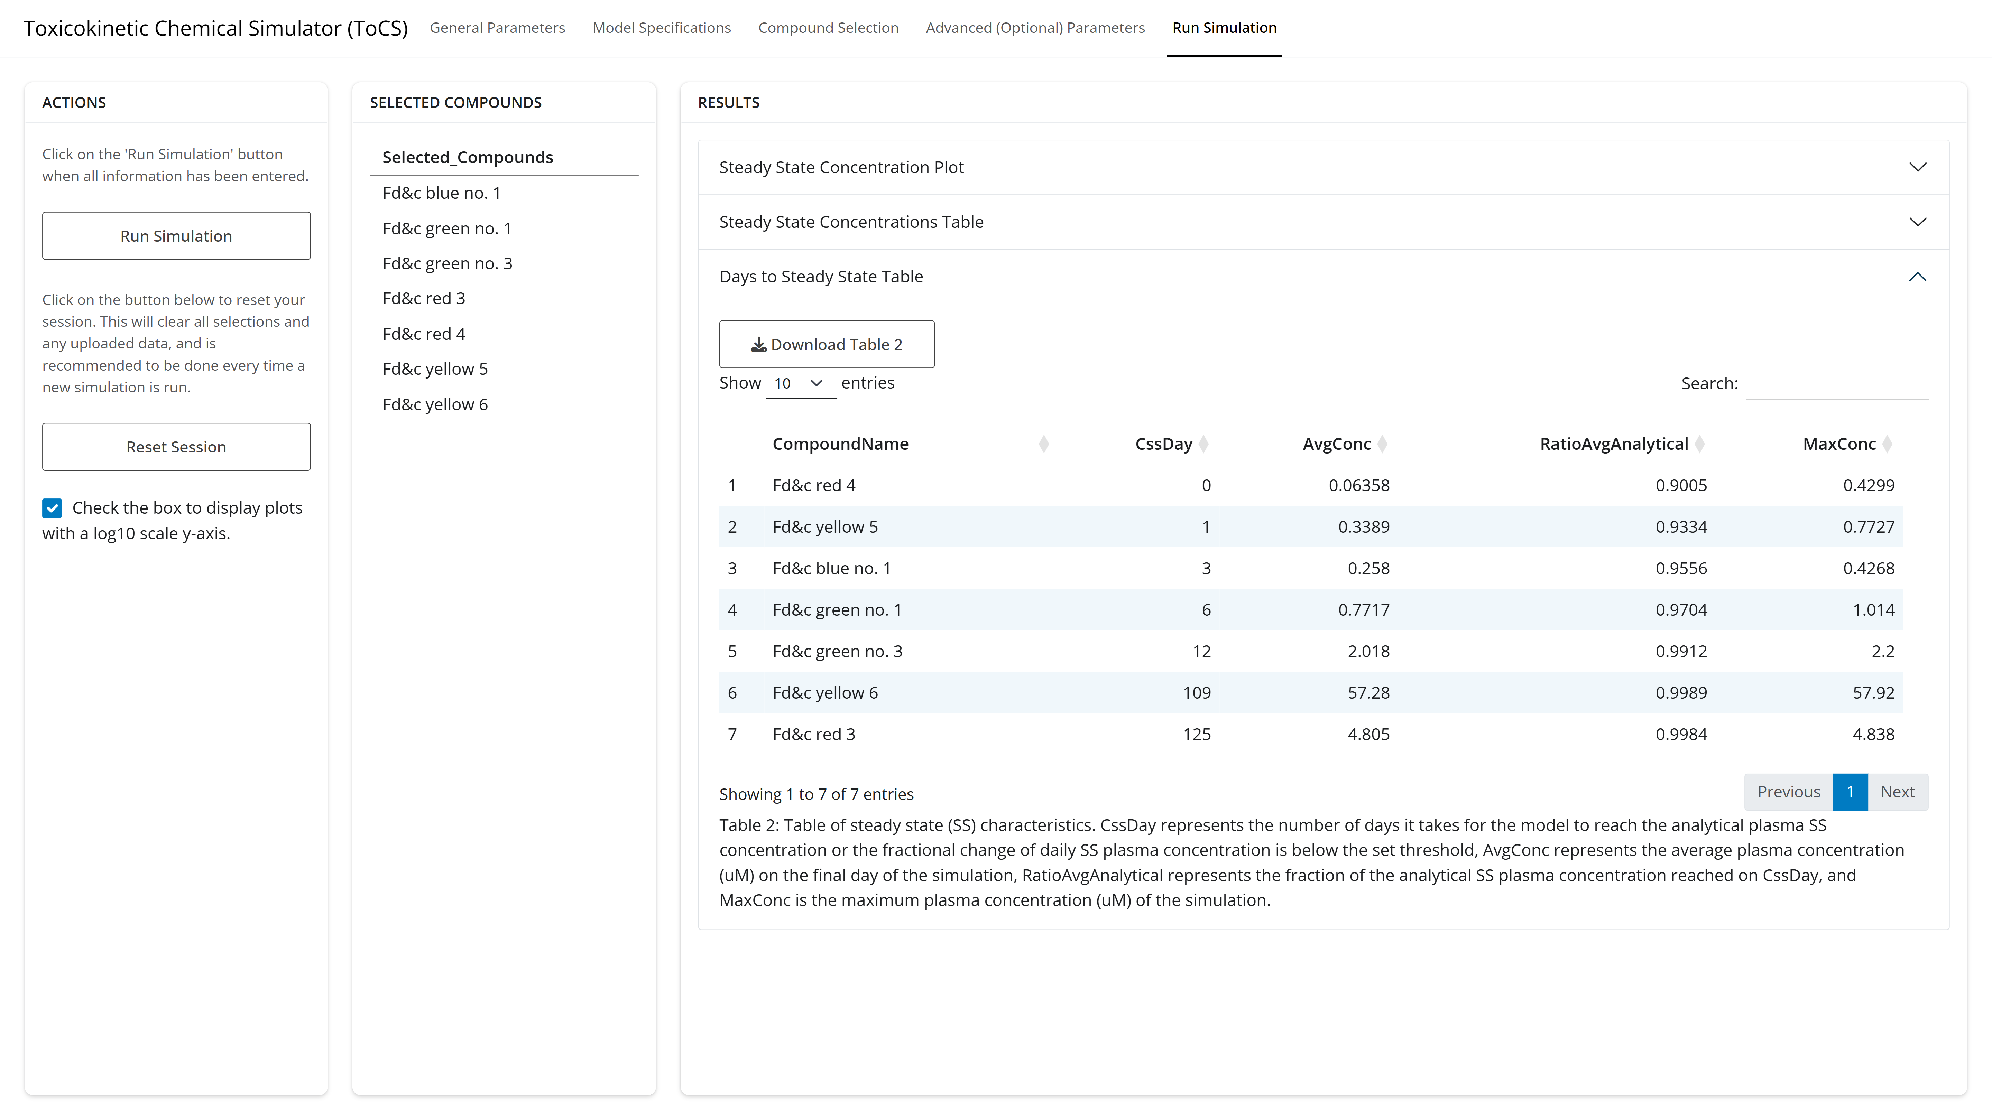
Example 1: Run Simulation Tab

Slide 17
Parameter Calculations Module Overview
Reasons for Use
Gain insight into common TK parameters/attributes of chemicals
Compare with in vivo data
Input into other mathematical models
Parameter Outputs:
Elimination rate
Half-life
Total plasma clearance
Volume of distribution
Partition coefficients for 13 tissues

Slide 18
Parameter Calculations Module Inputs
Required:
Species and species preferences (if applicable)
In silico parameter preference
Chemicals to simulate
Optional:
Bioavailability settings
Model calculation preferences for hepatic clearance, fraction unbound, and partition coefficients

Slide 19
Example 1 Scenario
Goal:
Obtain the human TK parameter values of seven food colorings
Use the available in silico parameters
Chemical Name | CASRN
FD&C Red 4 | 4548-53-2
FD&C Yellow 6 | 2783-94-0
FD&C Blue 1 | 3844-45-9
FD&C Yellow 5 | 1934-21-0
FD&C Red 3 | 16423-68-0
FD&C Green 3 | 2353-45-9
FD&C Green 1 | 4680-78-8

Slide 20
Example 1 Scenario
Goal:
Obtain the human TK parameter values of seven food colorings
Use the available in silico parameters
Chemical Name | CASRN
FD&C Red 4 | 4548-53-2
FD&C Yellow 6 | 2783-94-0
FD&C Blue 1 | 3844-45-9
FD&C Yellow 5 | 1934-21-0
FD&C Red 3 | 16423-68-0
FD&C Green 3 | 2353-45-9
FD&C Green 1 | 4680-78-8

Slide 21
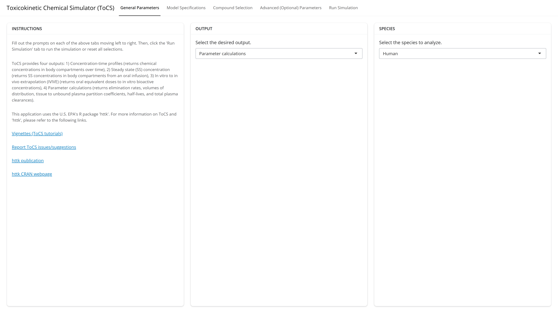
Example 1: General Parameters Tab

Slide 22
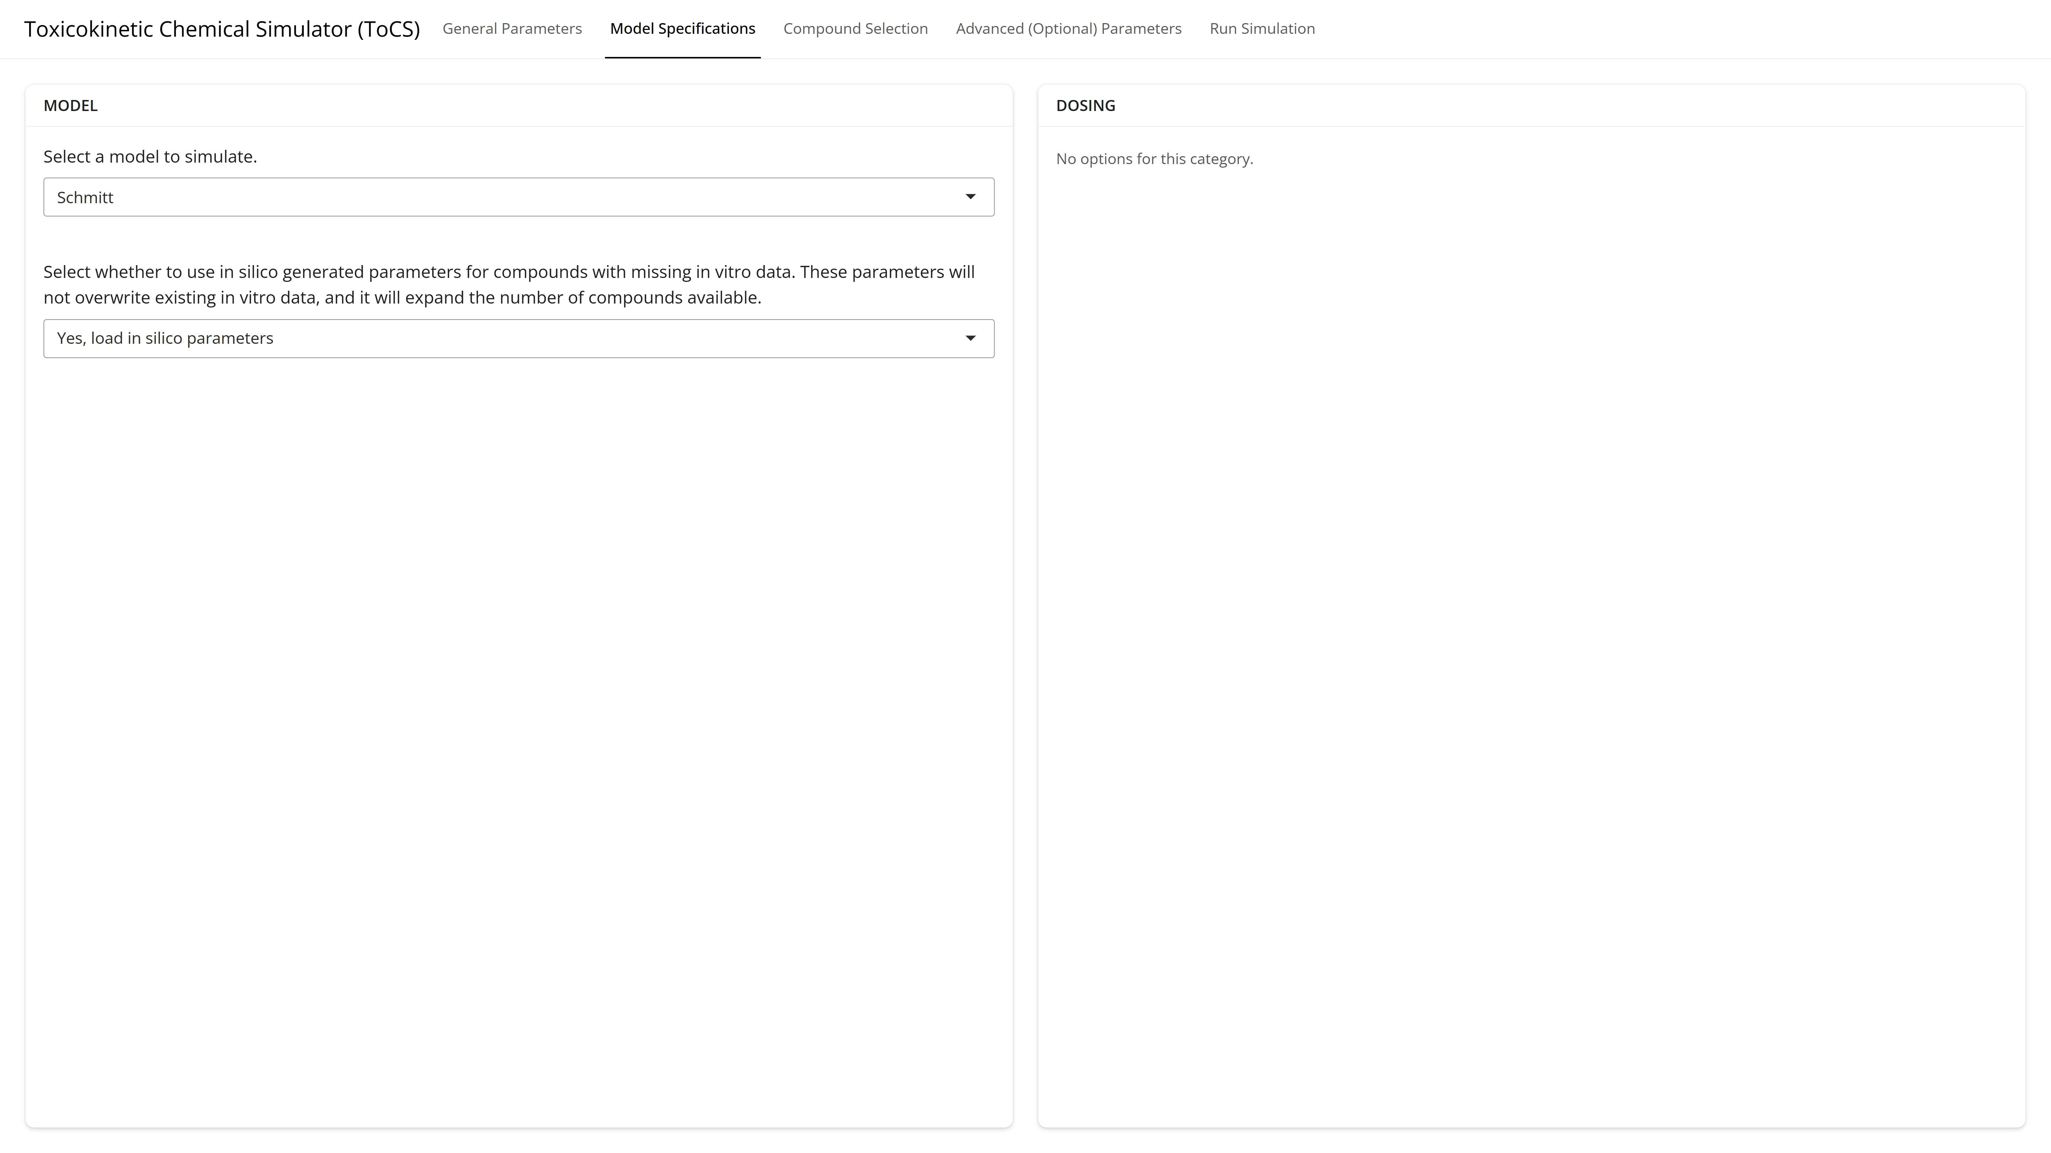
Example 1: Model Specifications Tab

Slide 23
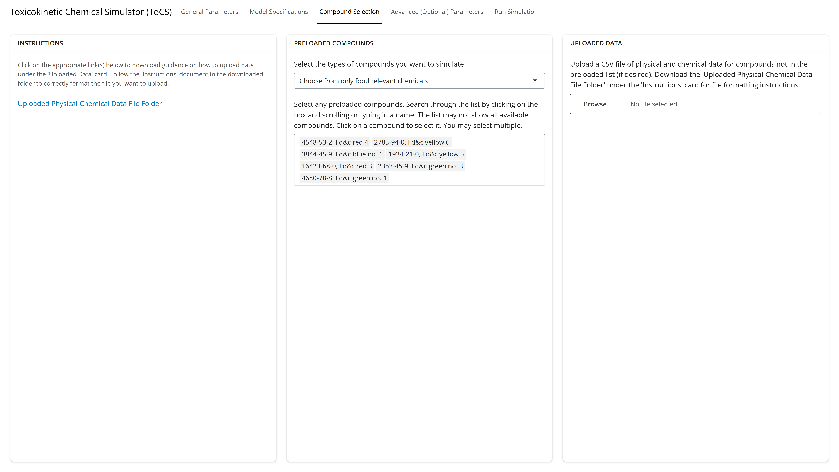
Example 1: Compound Selection Tab

Slide 24
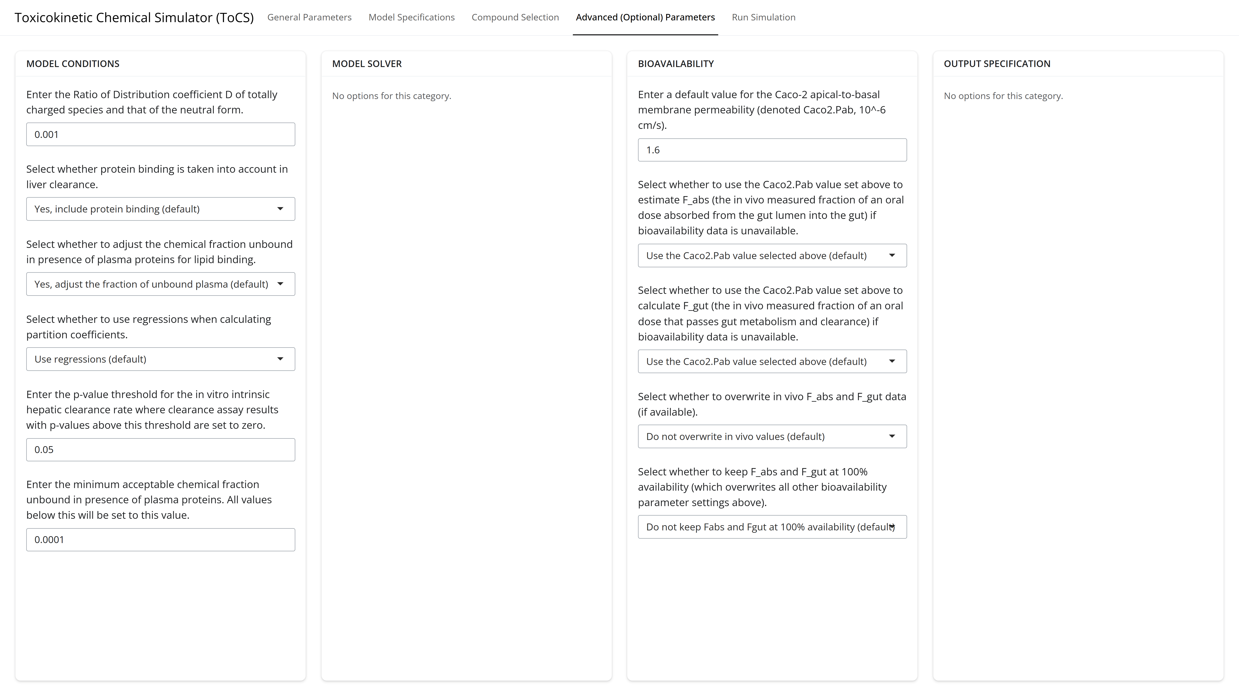
Example 1: Advanced Parameters Tab

Slide 25
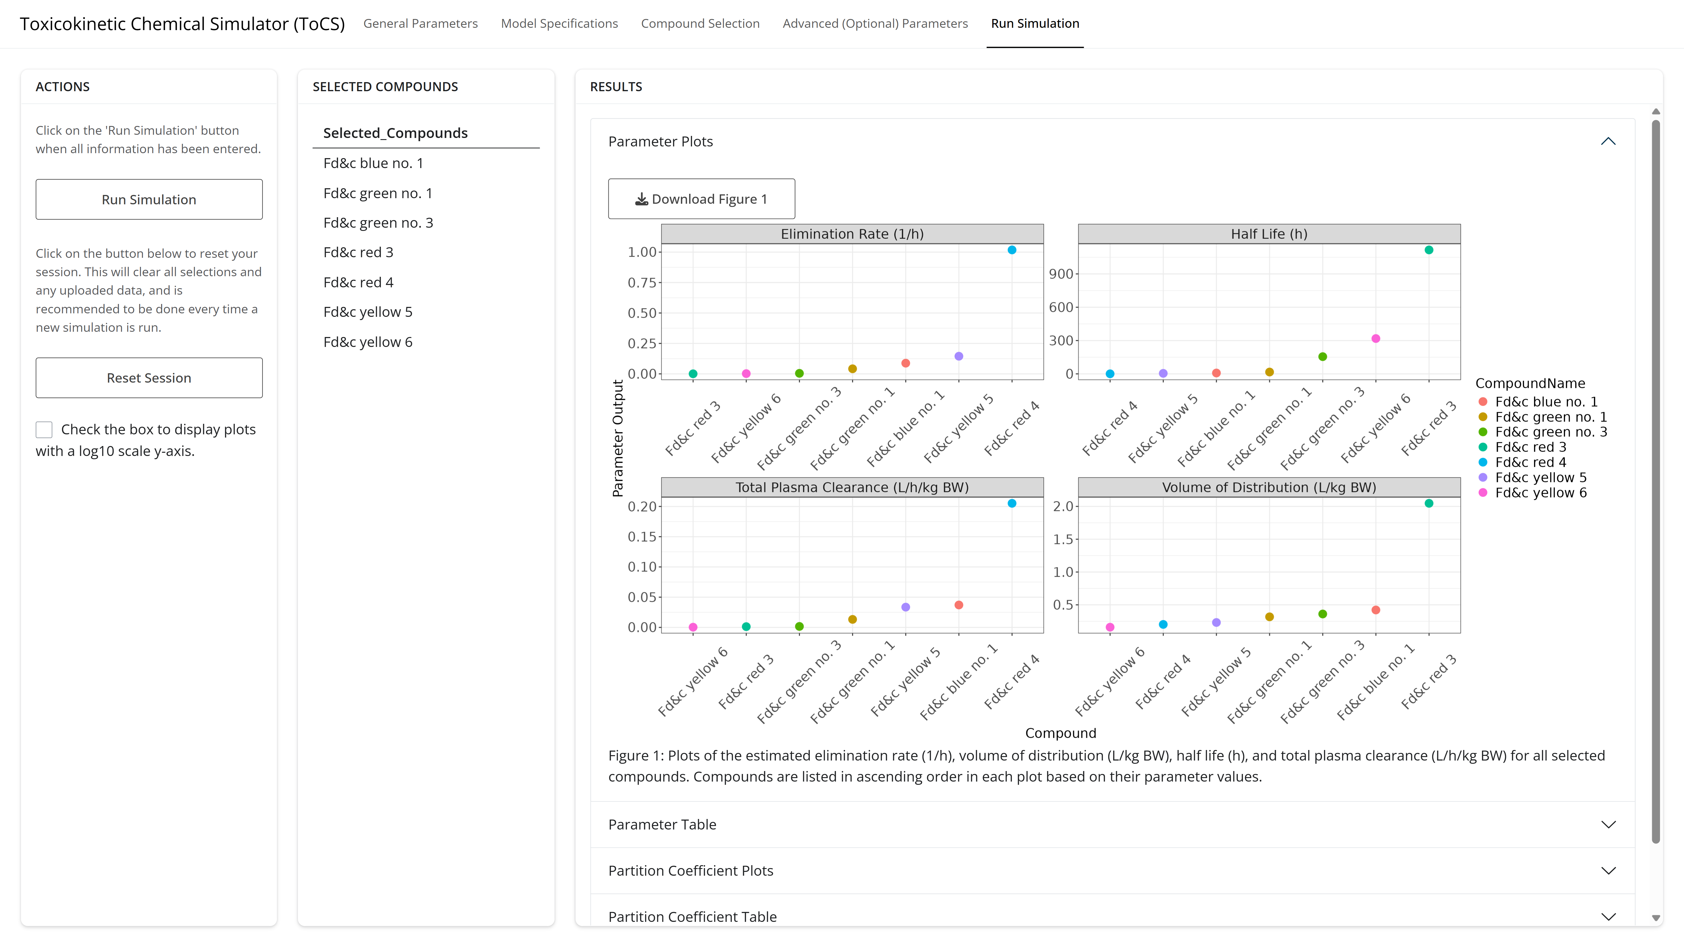
Example 1: Run Simulation Tab

Slide 26
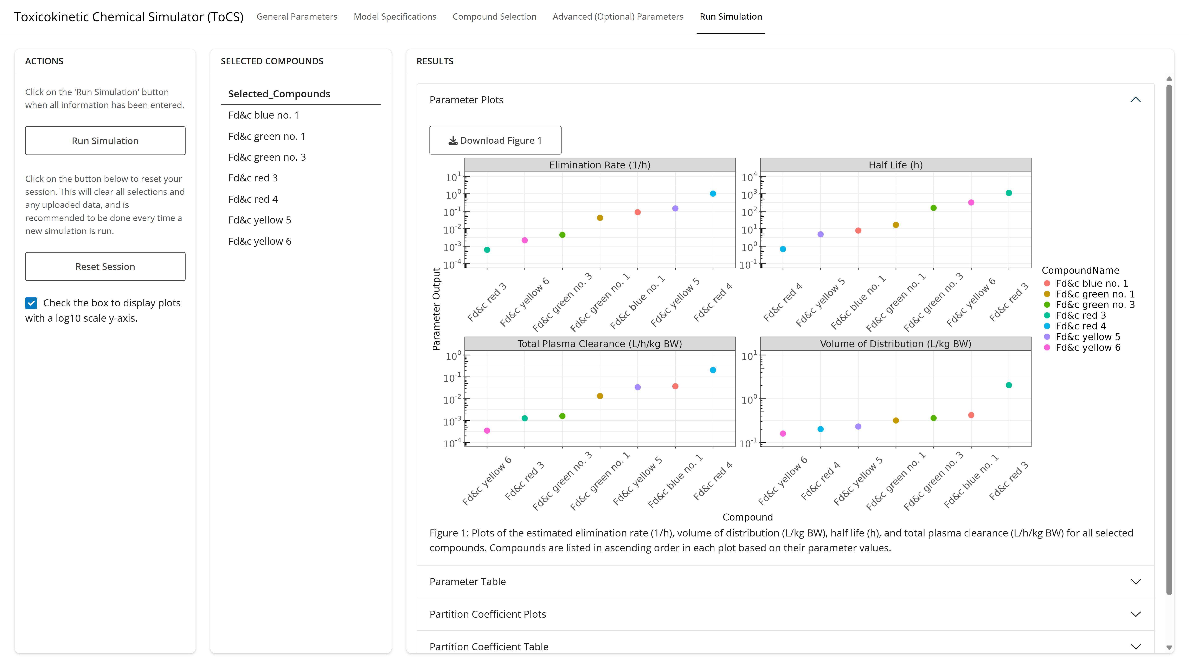
Example 1: Run Simulation Tab

Slide 27
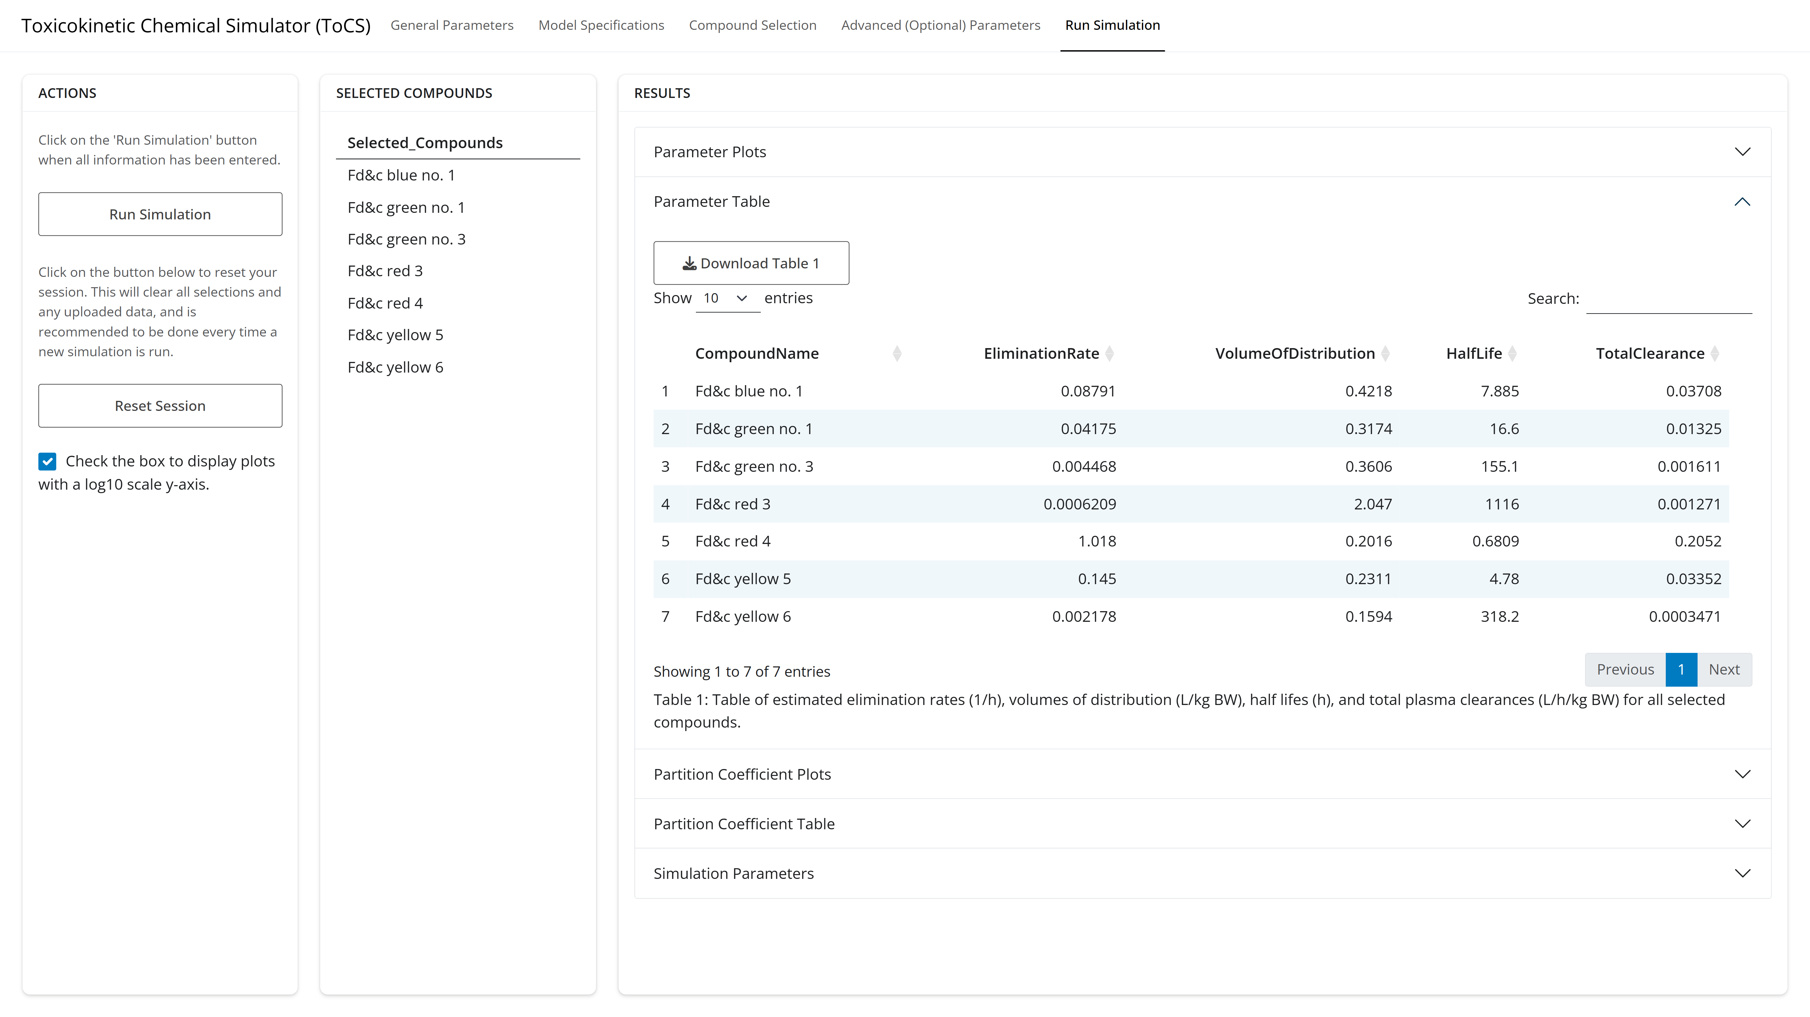
Example 1: Run Simulation Tab

Slide 28
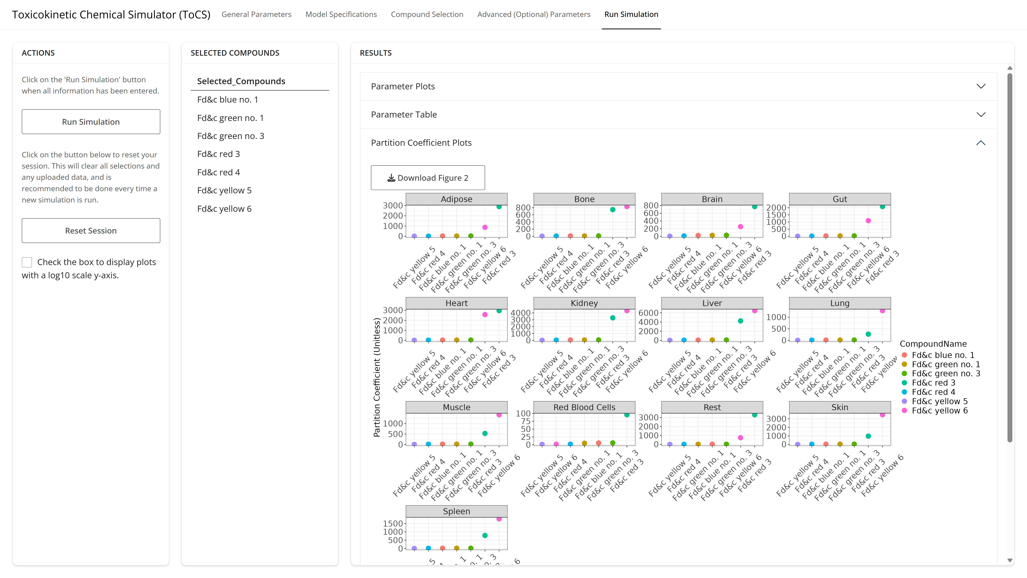
Example 1: Run Simulation Tab

Slide 29
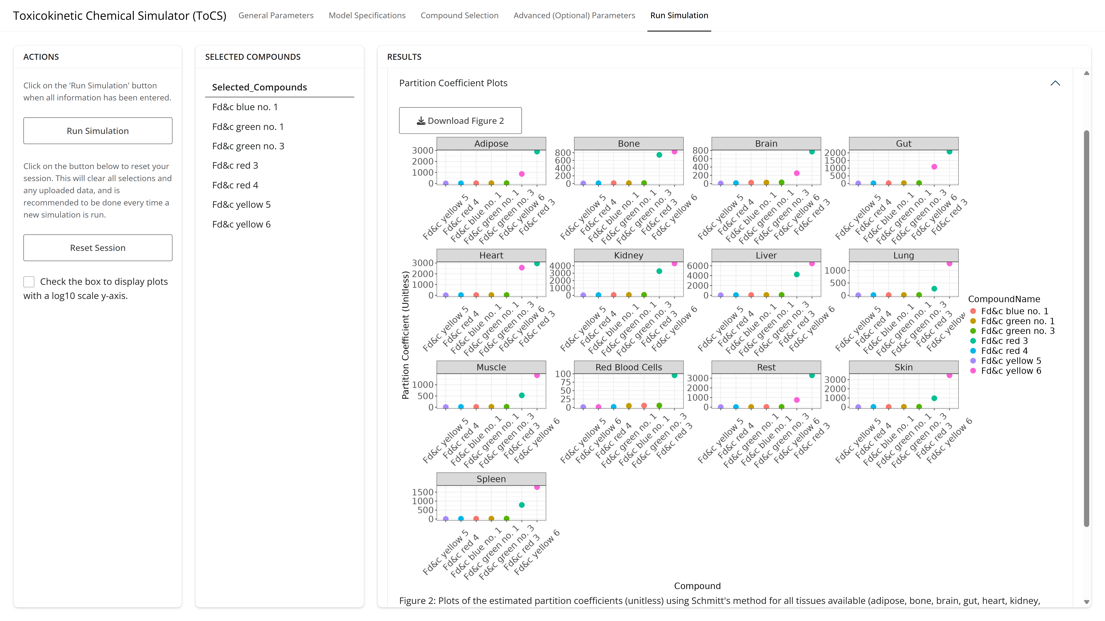
Example 1: Run Simulation Tab

Slide 30
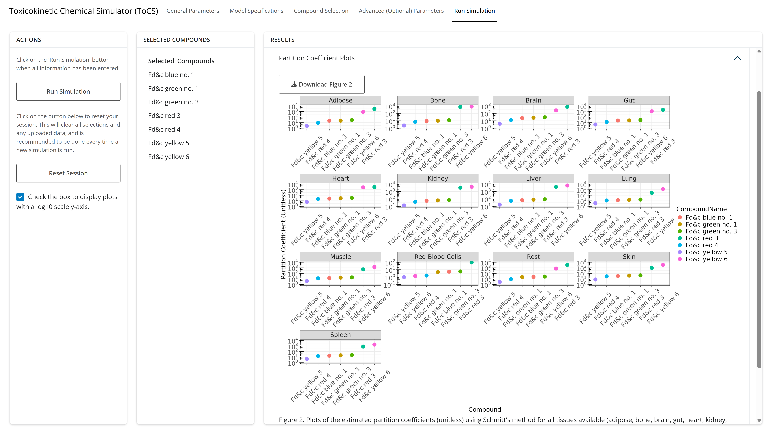
Example 1: Run Simulation Tab

Slide 31
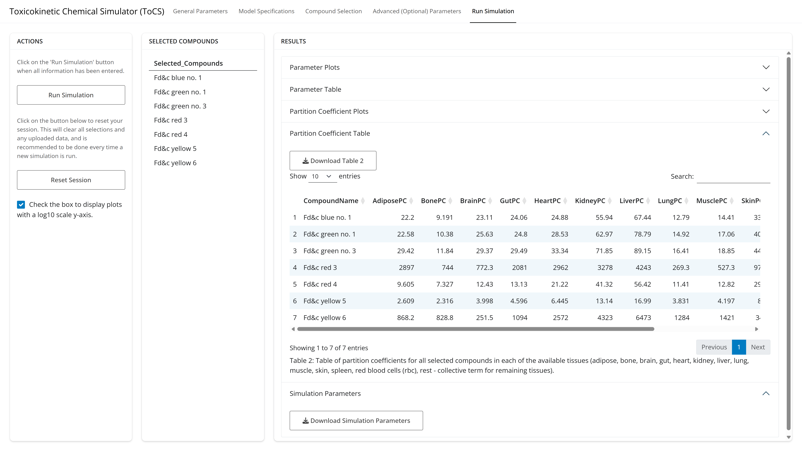
Example 1: Run Simulation Tab

